Slide 1
Gravity Wave Breaking in the Atmosphere
Thomas Lund
NorthWest Research Associates
Boulder, CO
Boulder Fluids Seminar
14 October, 2014

Slide 2
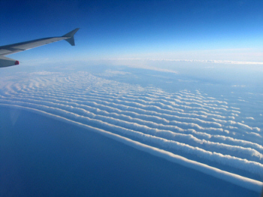
Outline
Introduction
  What are gravity waves?
  How are they similar/dissimilar to surface waves?
  Why do we care about them?
Analysis/Results
  Non-linear effects and wave breaking.
  Numerical Simulations.
Conclusions

Slide 3
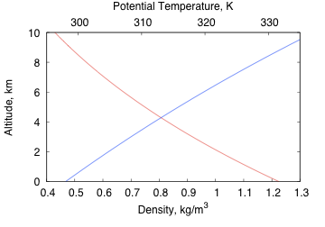
Stably Stratified Atmosphere
Potential
Temperature
Density

Slide 4
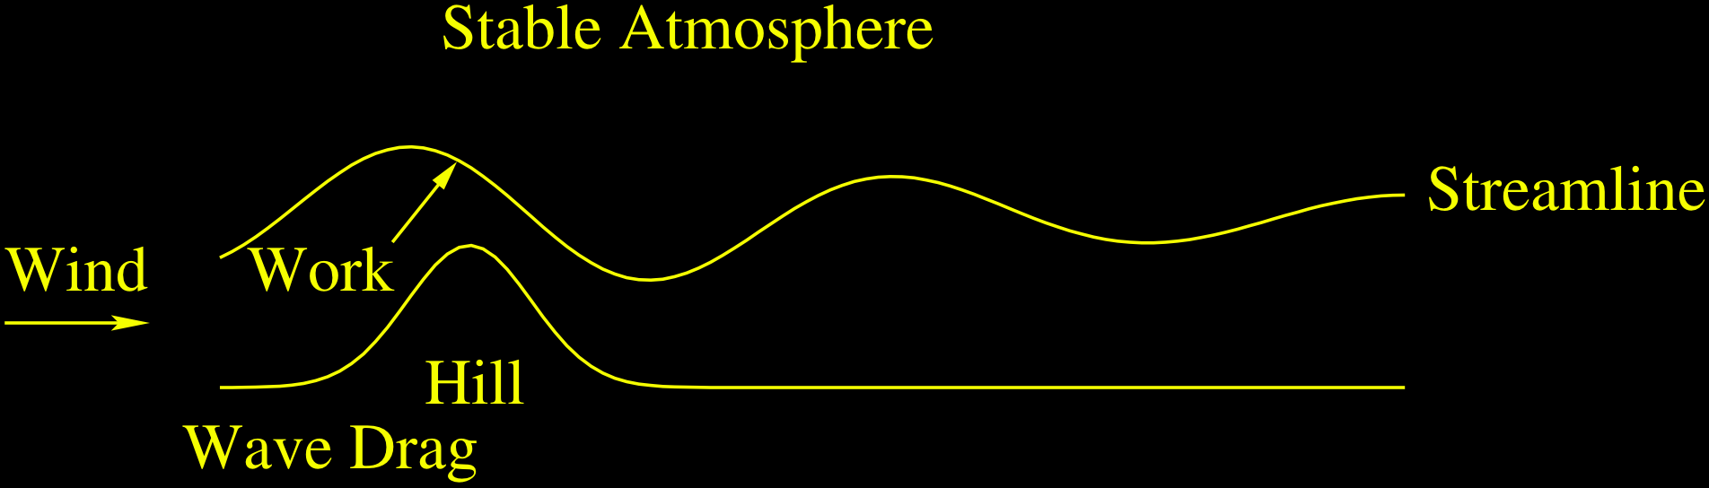
Terrain-Generated Gravity Waves

Slide 5
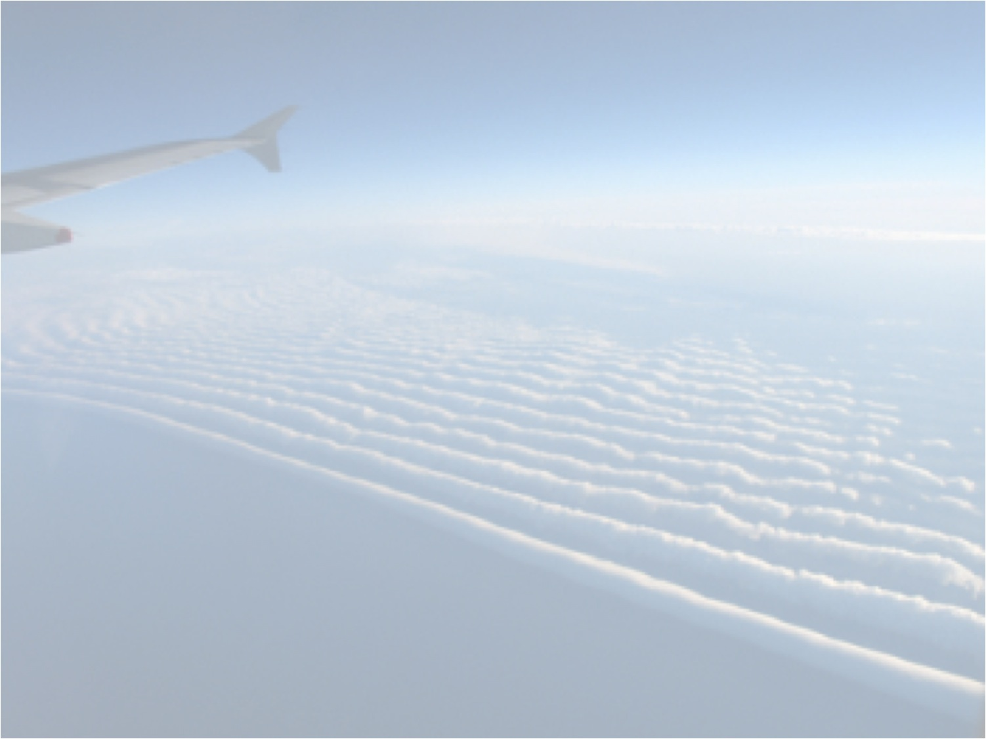
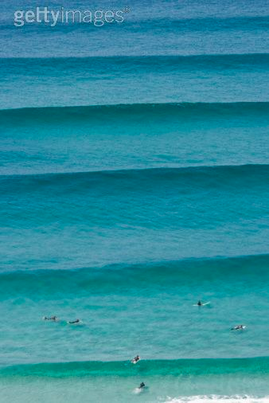
Analogy With Ocean Waves

Slide 6
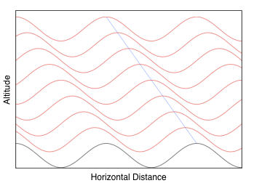
Internal Waves Propagate at an Angle

Slide 7
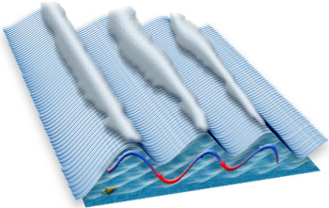
Visualizing Gravity Waves

Slide 8
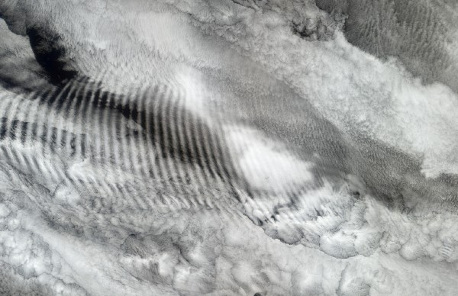
Gravity Waves Look Very Similar to Surface Waves!

Slide 9
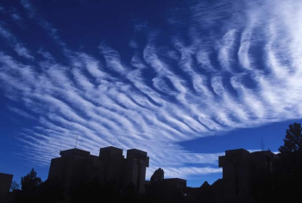
Often Producing Beautiful Sights

Slide 10

And Amazing Patterns

Slide 11
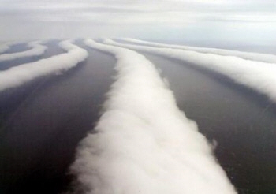
Sometimes Surreal

Slide 12
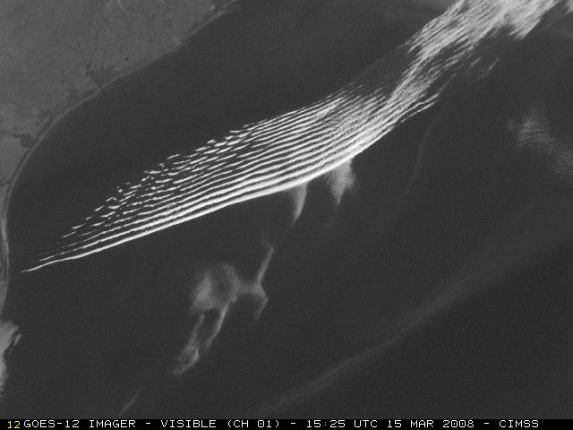
As Seen From Space

Slide 13
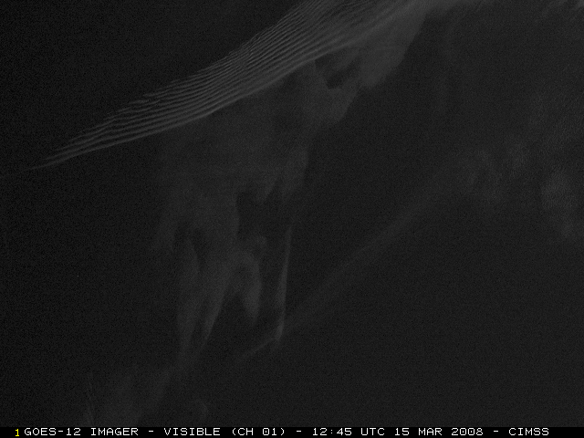
As Seen From Space

Slide 14
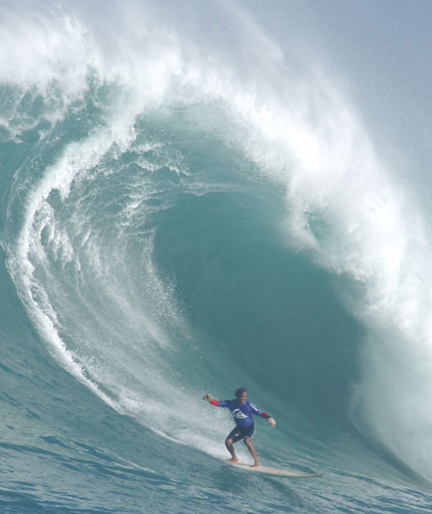
Wave Breaking

Slide 15


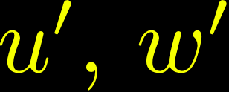
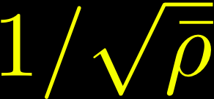
Variation with Altitude
  Like ocean waves, gravity waves exchange little or no energy or momentum with the background as they propagate.
  This means that the momentum flux is constant along the trajectory, i.e.
  Since decreases with altitude, must increase like

Slide 16
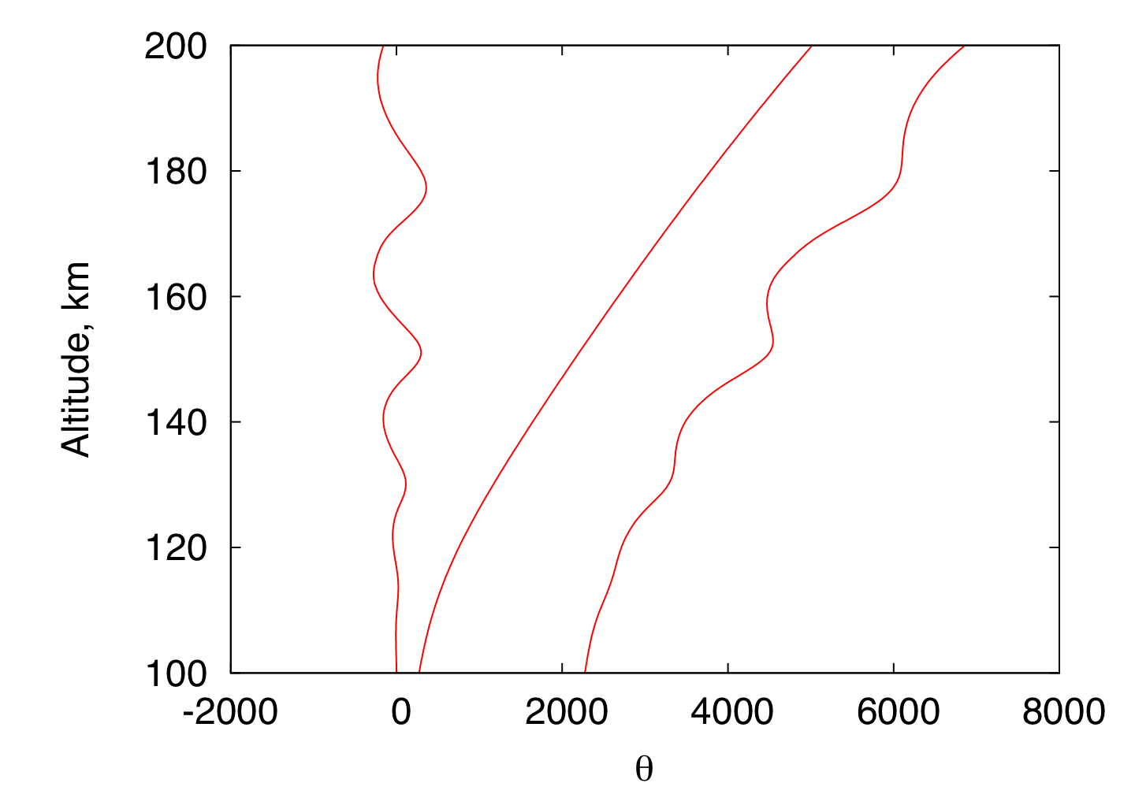
Mechanism for Wave Breaking
GW
Perturbation
Background
Composite
+
=
Unstable
Region

Slide 17
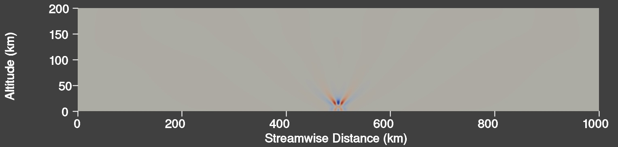
Numerical Simulation
Wind
Thunderstorm

Slide 18
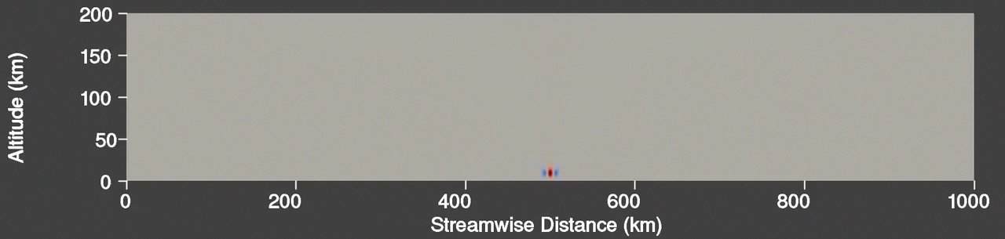
Animation of 2D Simulation
Thunderstorm

Slide 19
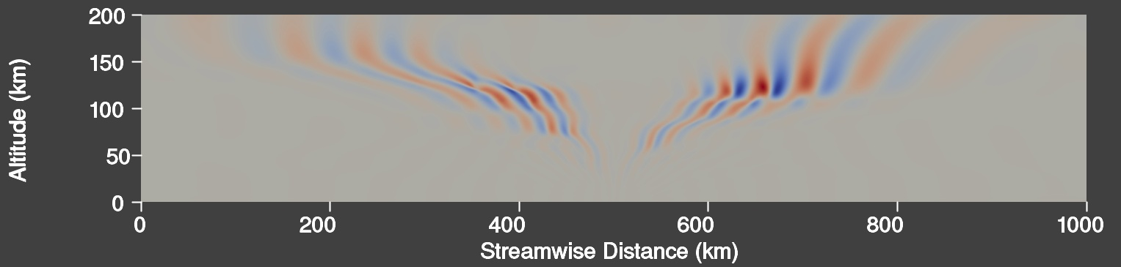
High-Resolution 3D Domain
Wind
High-Resolution
Domain
Thunderstorm

Slide 20
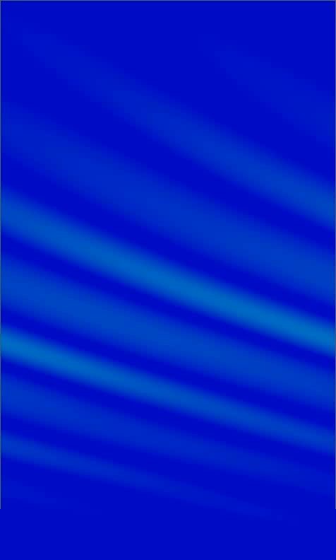
Vertical-Streamwise
View

Slide 21
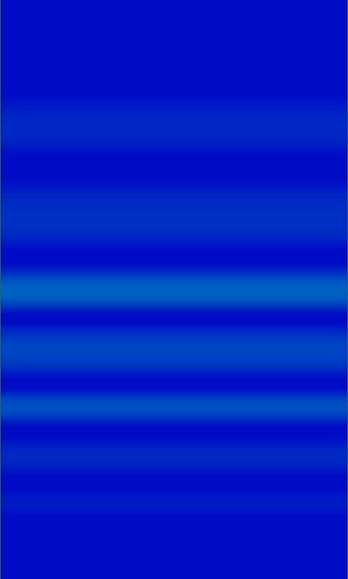
Vertical-Spanwise
View

Slide 22
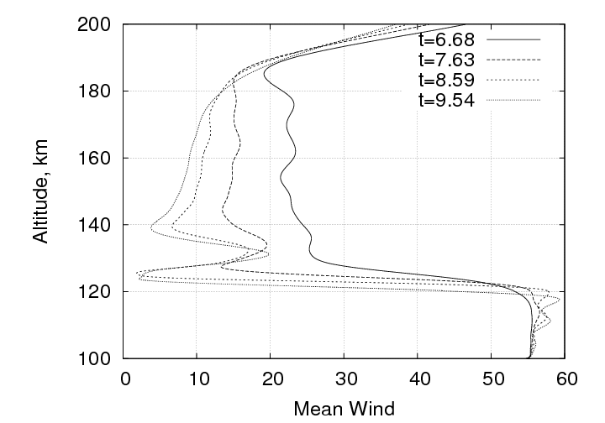
Mean Flow Acceleration

Slide 23
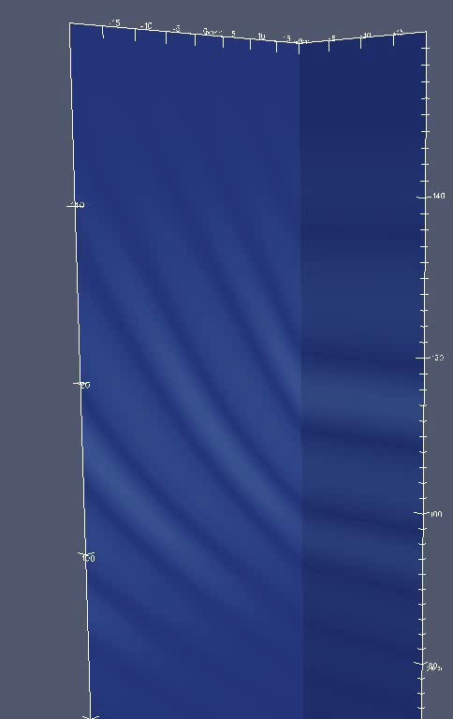
Localized wave
packet

Slide 24
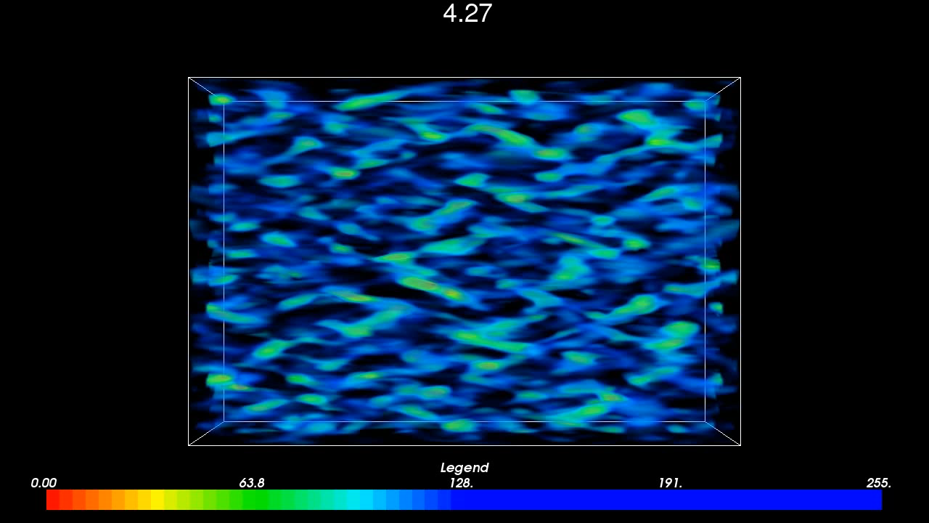
Turbulent Structure Visualization
Vertical-Spanwise
View
Simulation and graphics by Ling Wang

Slide 25
Summary
  Gravity waves generated near the surface can propagate to much higher levels in the atmosphere.
  Breaking releases stored momentum and energy and leads to turbulent mixing and to altered mean winds.
  High-Resolution numerical simulation can be used to better understand the nature of GW instability and to generate databases from which GW parameterizations can be formed.

